Slide 1
A New Vacation For the New Normal

Slide 2
Disclaimer
This presentation has been prepared by Paradise Park Venture LLS (the “Company”) and is general background information about the Company’s activities at the date of this presentation. The information in this presentation is provided in summary form only and does not purport to be complete. This presentation does not contain all the information that is or may be material to investors or potential investors and should not be considered as advice or a recommendation to investors or potential investors in respect of the holding, purchasing or selling of securities or other financial instruments and does not take into account any investor’s particular objectives, financial situation or needs. The contents of this presentation should not be considered to be legal, tax, investment or other advice, and any investor or prospective investor considering the purchase or disposal of any securities of the Company should consult with its own counsel and advisers as to all legal, tax, regulatory, financial and related matters concerning an investment in or a disposal of such securities and as to their suitability for such investor or prospective investor. This presentation and its contents are confidential and proprietary to the Company, and no part of it or its subject matter may be reproduced, redistributed, passed on, or the contents otherwise divulged, directly or indirectly, to any other person (excluding the relevant person’s professional advisers) or published in whole or in part for any purpose without the prior written consent of the Company. If this presentation has been received in error, it must be returned immediately to the Company.
This presentation contains forward‐looking statements. These statements may include the words “believe”, “expect”, “anticipate”, “intend”, “plan”, “estimate”, “project”, “will”, “may”, “targeting” and similar expressions as well as statements other than statements of historical facts including, without limitation, those regarding the financial position, business strategy, plans, targets and objectives of the management of the Company for future operations (including development plans and objectives).
Such forward‐looking statements involve known and unknown risks, uncertainties and other important factors which may affect the Company's ability to implement and achieve the economic and monetary policies, budgetary plans, fiscal guidelines and other development benchmarks set out in such forward‐looking statements and which may cause actual results, performance or achievements to be materially different from future results, performance or achievements expressed or implied by such forward‐looking statements. Such forward‐looking statements are based on numerous assumptions regarding the Company’s present and future policies and plans and the environment in which the Company will operate in the future. Nothing in the foregoing is intended to or shall exclude any liability for, or remedy in respect of, fraudulent misrepresentation. The information in this presentation has not been independently verified. No representation or warranty, express or implied, is made as to the fairness, accuracy or completeness of the presentation and the information contained herein and no reliance should be placed on it. Information in this presentation (including market data and statistical information) has been obtained from various sources (including third party sources) and the Company does not guarantee the accuracy or completeness of such information. All projections, valuations and statistical analyses are provided for information purposes only. They may be based on subjective assessments and assumptions and may use one among alternative methodologies that produce different results and to the extent they are based on historical information, any they should not be relied upon as an accurate prediction of future performance. Any financial data in this presentation are solely for your information, as background to the Company and may not be relied upon for the purpose of entering into any transaction whatsoever. The financial information set out in this presentation is based on certain important assumptions and adjustments and does not purport to represent what our results of operations are on an audited basis or actually will be in any future periods. Furthermore, no representation is made as to the reasonableness of the assumptions made in this presentation or the accuracy or completeness of any modelling, scenario analysis or back‐testing. The information in this presentation is not intended to predict actual results and no assurances are given with respect thereto. None of the Company, its advisers, connected persons or any other person accepts any liability whatsoever for any loss howsoever arising, directly or indirectly, from this presentation or its contents. All information, opinions and estimates contained herein are given as of the date hereof and are subject to change without notice.

Slide 3
Paradise at the Lake
Required investment | $4,315,513
Offering | 65% Equity with a 3% Guaranteed return Yr. 1 8% Preferred Equity after Yr1
Commitment | 5-year commitment with sale expected in year 5
Expected asset value | At a 10% Cap Rate this asset is expected to be valued at roughly $16mm once stabilized
Expected net income | Approximately $133,190 per month
Projected ROI | Projected 5-year ROI 30%

Slide 4
Our Story
Baby Boomers are Calling it quits and It's being called the Great Retirement or the Silver Tsunami.
Roughly 74 Million Baby Boomers will retire by 2031 and 50% of privately held businesses are owned by this group.
That means 10,000 boomers retire per day 10% of them own a business.
2.4 million Businesses for sale that are running with Fax machines, Bad or no websites & Handwritten ledgers. As the next generation takes over, that will all change. It’s an excellent time to choose a niche and become the very best in that narrow area.
Our specialty is upscale RV Park investing.
No industry we've seen is so rife with these outdated business practices.
This asset class is closer to 80% owned by the boomer generation with
old style business habits. More than 50% of RV Parks will change
hands and 500-600 new parks must be built in the next
5 years just to keep up with demand.

Slide 5
The Problems
Fragmented
mom and pops
No institutional money
Owners don’t use online booking
Owners don’t use dynamic pricing
Owners don’t reinvest in the asset
The PARADISE Opportunity
RV Parks today are what
Storage was 25 years ago

Slide 6
The PARADISE Solution
These Assets are highly undervalued due to outdated business practices. To Value-add these assets we Integrate top quality hospitality technology into every facet of our business.
EXPRESS CHECK-IN
POINT-OF-SALE MANAGEMENT
RECURRING BILLING
& AUTOPAY
ADDITIONAL REVENUE STREAMS
We collect electronic signatures and contactless payment while sharing automated guest messages through email and text.
Allows us to track inventory
in real-time, completely integrated with the software and credit card payments. This eliminates errors, shortages, and slippage.
Automated invoicing and payments for long term guests made online and without the site manager's time drag
Add-ons and upgrades are marketed automatically by email and text before and during the renter's stay

Slide 7
The Industry
2020 Resulted in The RV Industry churning out more product than ever. Americans looked for ways to travel without staying in motels or riding in airplanes.
The National Association of RV Parks and Campgrounds
Thor Industries Inc
Winnebago Industries Inc
The National Association of RV Parks and Campgrounds
Wholesale shipments of RVs in North America are expected to hit a record 602,200 units this year - a 40% increase over 2020
the largest producer, reported record results for its fiscal first quarter while noting its backlog as of the end of October was over $18 billion - a 100% increase over a year ago.
Winnebago Industries Inc (WGO.N) reported record fiscal 2020 revenues in October - up over 50% from the previous year. it is expected to post its second straight quarter of sales over $1 billion and a 33% increase in earnings per share", -Refinitiv.
Estimates more than
53,000
new RV sites will be constructed across the nation.

Slide 8
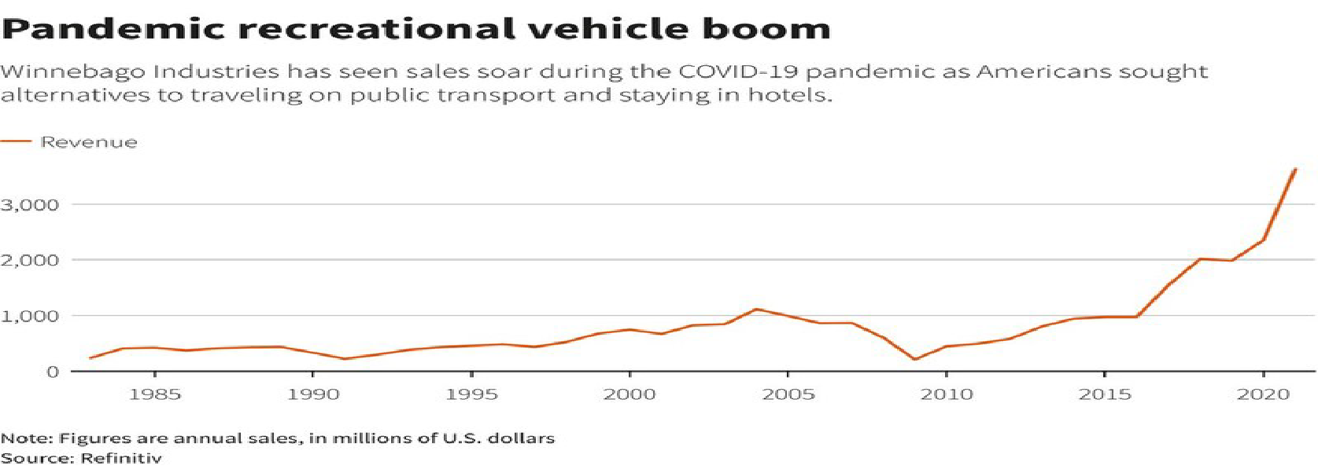
Pandemic Recreational Vehicle Boom
Winnebago Industries has seen sales soar during the COVID-19 pandemic as Americans sought alternatives to traveling on public transport and staying in hotels.
Note: Figures are annual sales, in millions of U.S. dollars
Source: Refinitiv

Slide 9
Pandemic Recreational Vehicle Boom
Winnebago Industries has seen sales soar during the COVID-19 pandemic as Americans sought alternatives to traveling on public transport and staying in hotels.
Note: Figures are annual sales, in millions of U.S. dollars
Source: Refinitiv

Slide 10
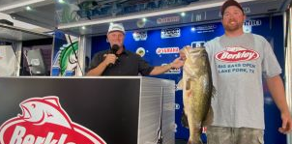
Lake Fork
Lake Fork is the #1 Bass Fishing Lake in Texas and Top 10 the USA
60+ Bass fishing Tournament a year!!
Discovery Channel broadcast Fork Tournaments
CBS Sports outdoor
Bass Champs Texas
Legend of Lake Fork $210,000 Cash and prizes
Professional angler's face-off in the high-stakes 2022 Bass Pro Tour, all striving to earn a spot in the Bass Pro Tour Championship on Lake Fork.
Major League Fishing is an enterprise developed through a joint effort between Outdoor Channel and two dozen of the world’s best-known bass fishing anglers. Major League Fishing takes viewers inside the boats of the competitors as they battle each other during a six-day event set in various locations across the country.
Dylan Brill, Choctaw, OK, tops over 1000 anglers at 17th annual Berkley Big Bass on Fork with a 7.93 and takes home a new Skeeter ZX 200 - Yamaha 200 SHO $79,000.
2023 Legends of Lake Fork Big Bass Tournament Gives away 3 Xpress Boats and 100s of
other prizes in the amount of over $210,000.

Slide 11
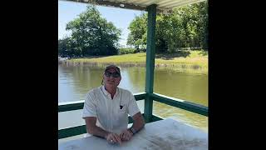

Slide 12
PARADISE PARTNERS

Slide 13
PARADISE MARKETING PARTNERS

Slide 14
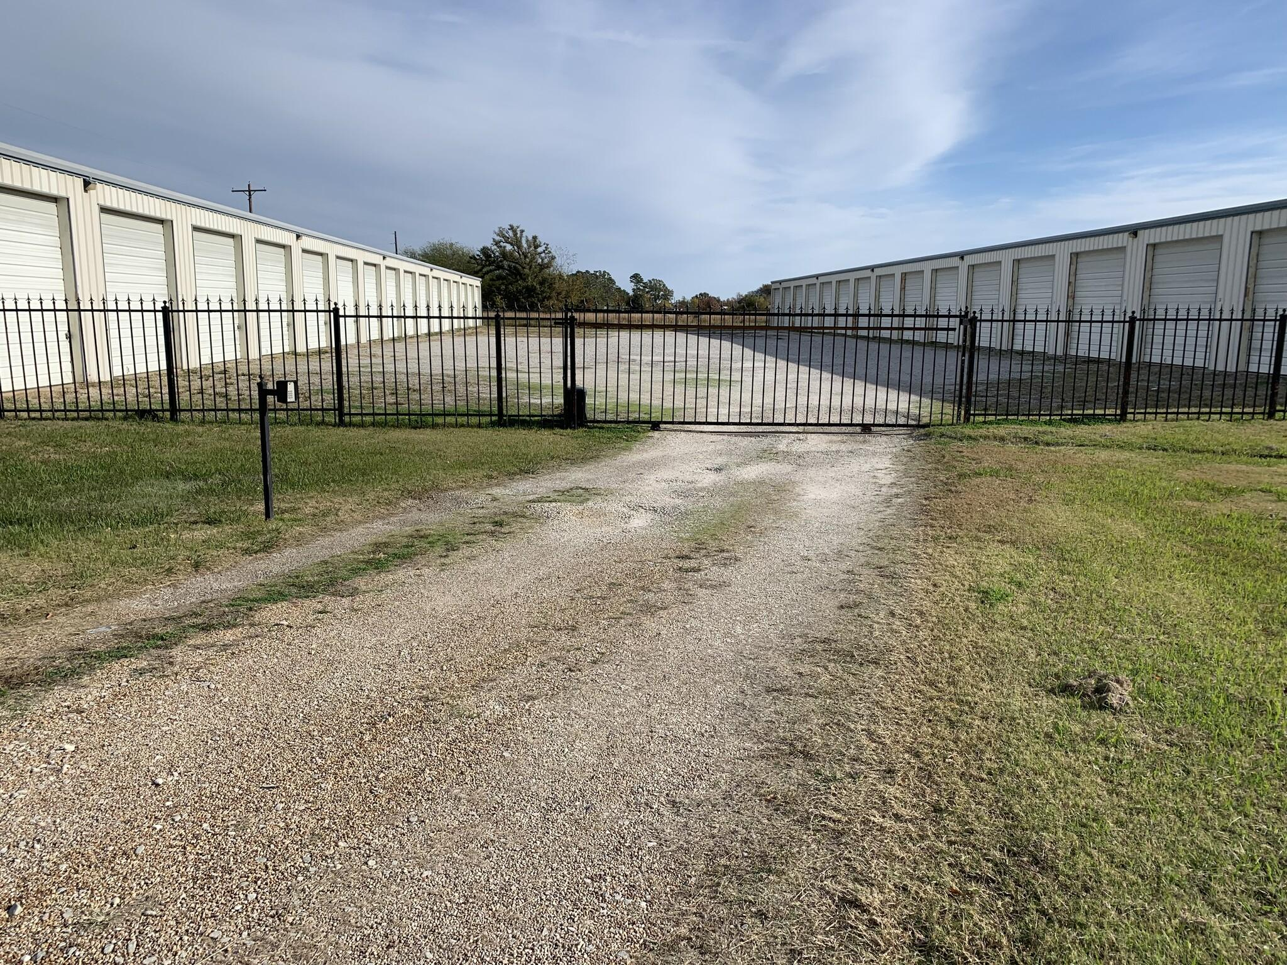
Boat Storage 32 units 100% occupied with a waiting list

Slide 15
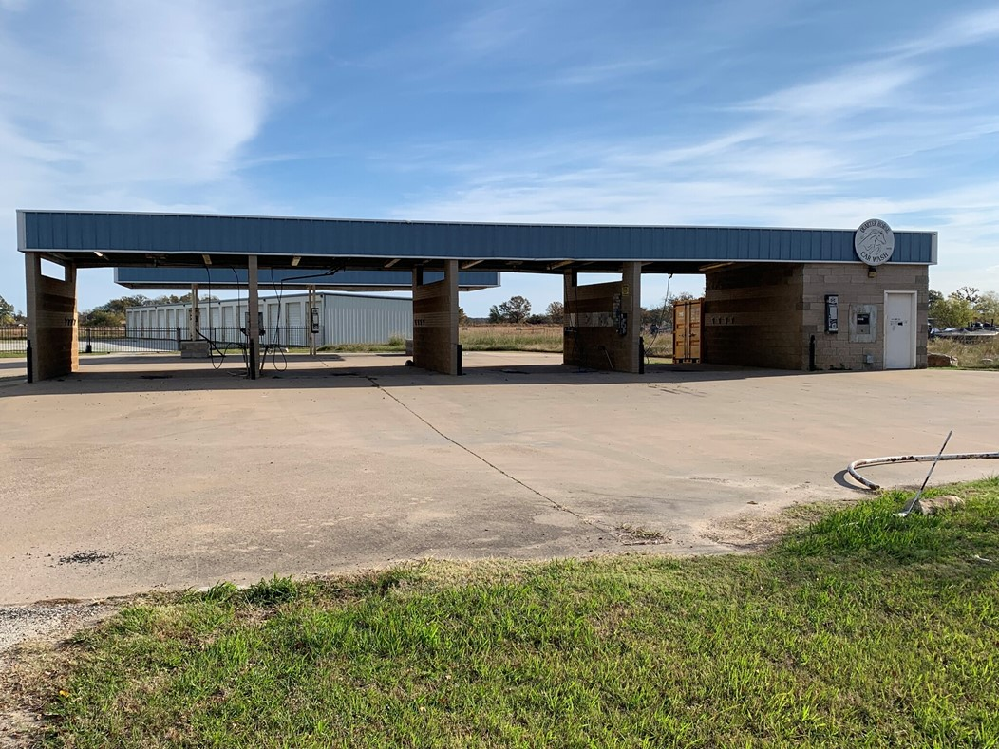
Car Wash to be Replaced with a Wide Entrance.

Slide 16
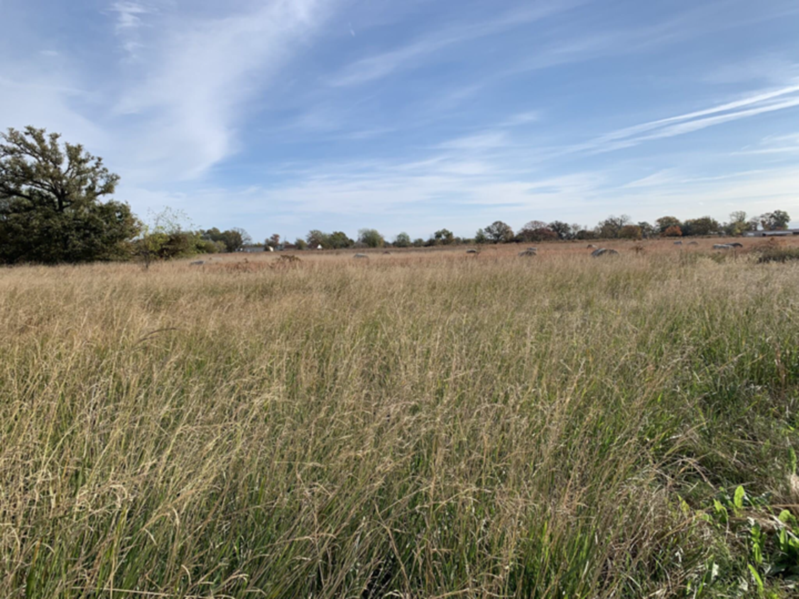
16 acres of raw land to build 75-unit
RV Resort and Campground

Slide 17
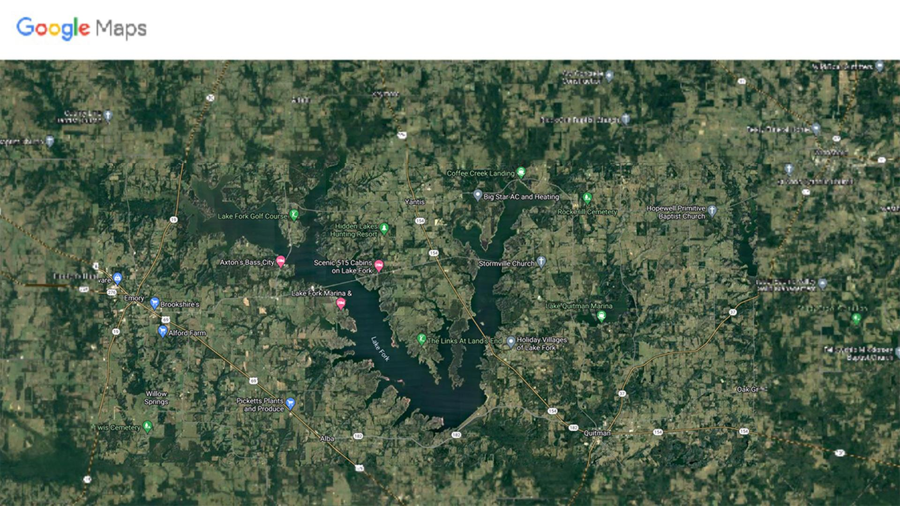
Our Property
New State Park

Slide 18
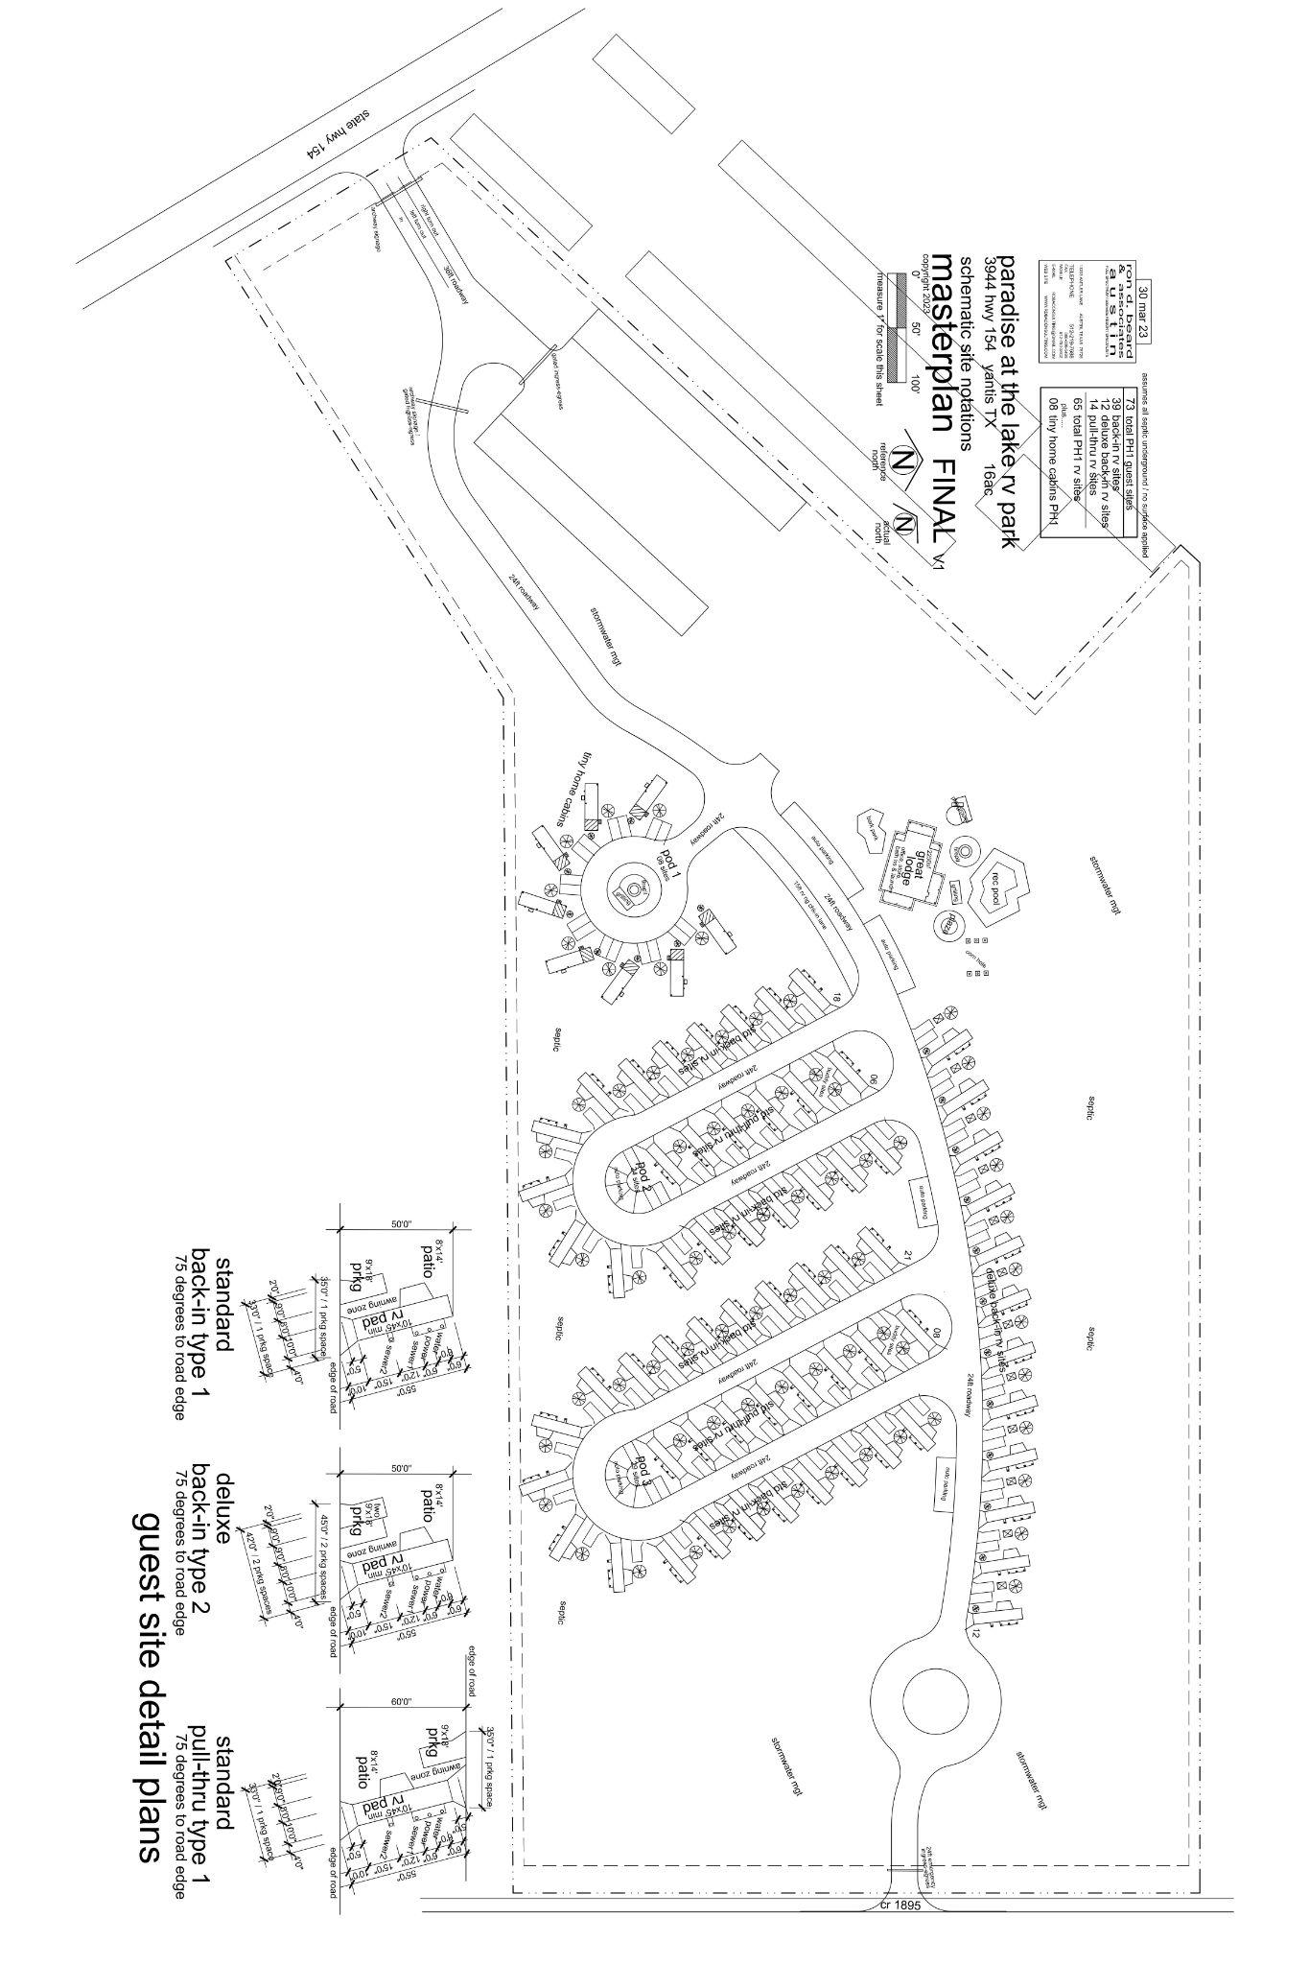

Slide 19
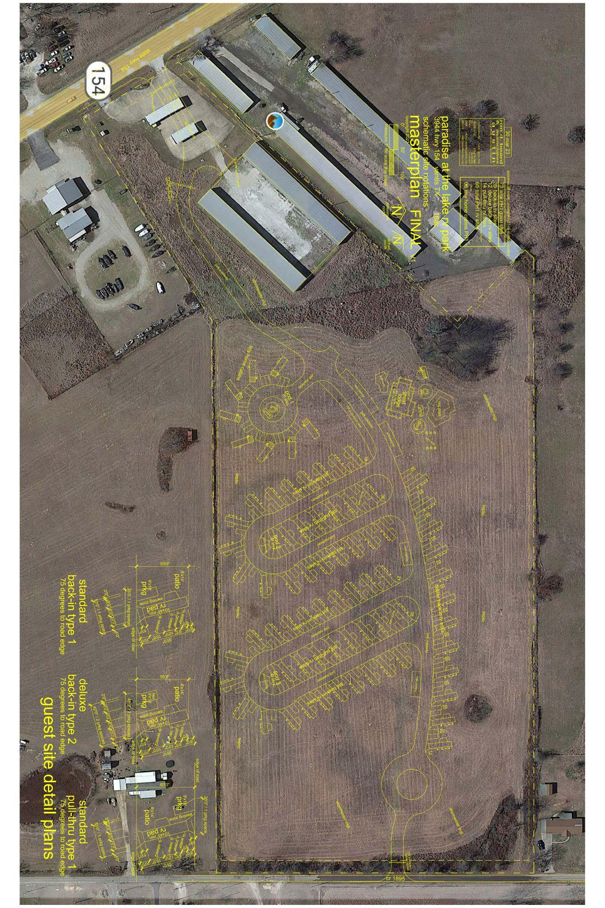

Slide 20
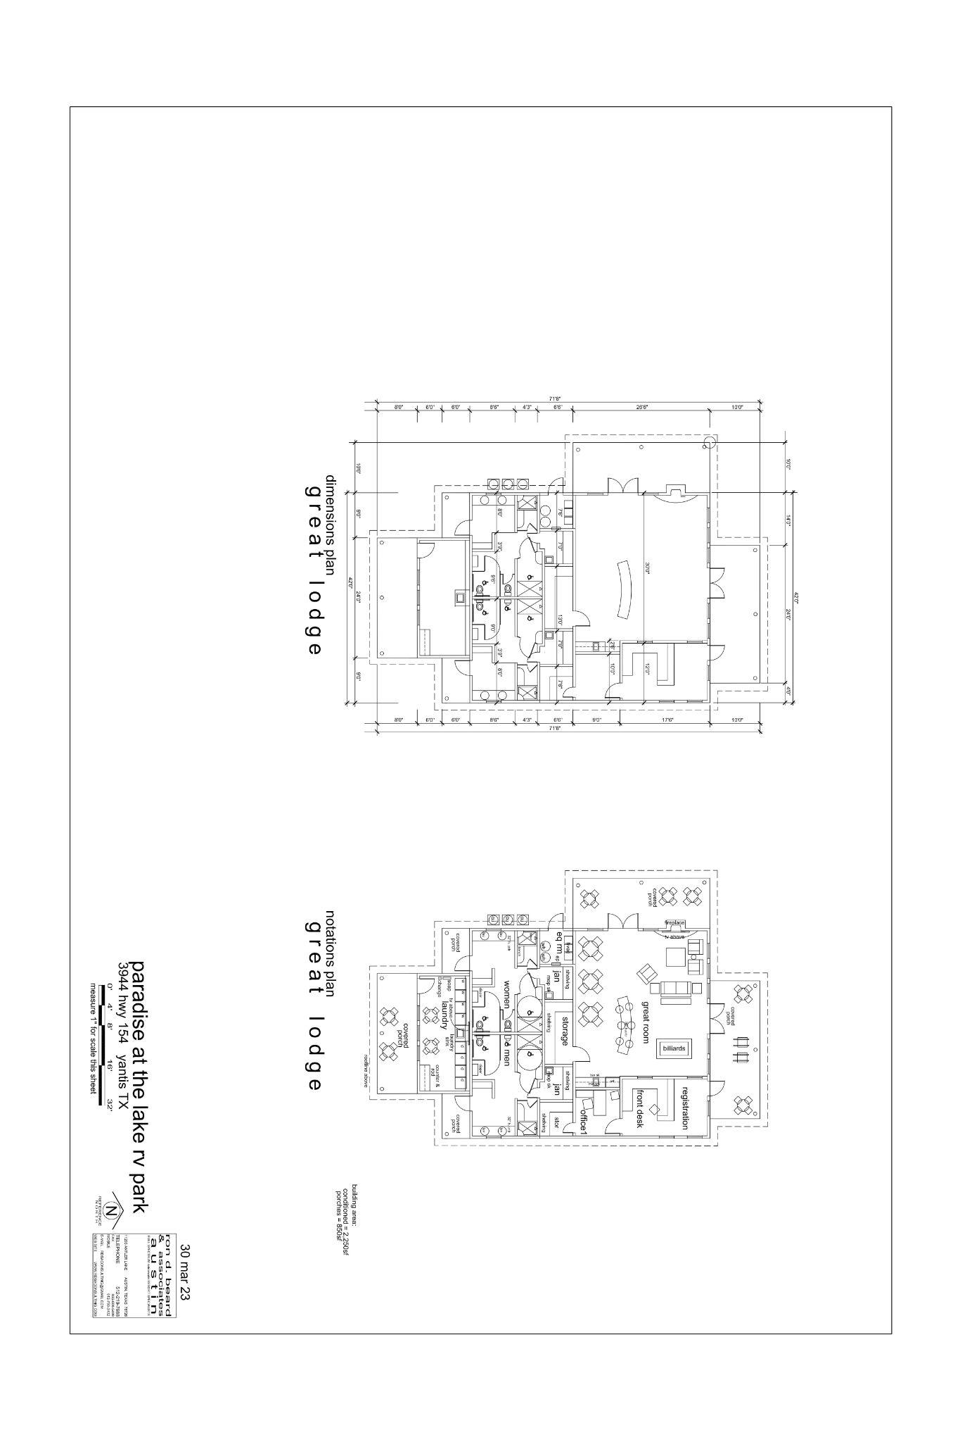

Slide 21
THE DETAILS Income at 85% occupancy
Unit Mix | Nightly Rate | Monthly Income Per unit | Number of Units | Occupancy Percentage | Monthly Income
Back in | 55 | $1,650 | 39 | 85% | $54,698
Long term Back in | 35 | $1,050 | 12 | 85% | $10,710
Pull Through | 65 | $1,950 | 24 | 85% | $39,780
PremiumPull Through | 75 | $2,250 | 15 | 85% | $28,688
Cabin | 150 | $4,500 | 8 | 85% | $30,600
Boat Storage | 140 | $140 | 32 | 100% | $4,480
 |  |  | 130
 |  |  |  |  | $168,955 | Monthly total

Slide 22
THE SALE 85% Occupancy
LP Equity : 65% | Sponsor : 35%
Yearly NOI | $1,388,700
Sales CAP | 10.00%
Asset Value | $13,886,997
60% LTV | $8,332,198
$13,886,997
Sales value

Slide 23
THE DETAILS COSTS AND DISTRIBUTIONS
65%
LP Equity
35%
Sponsor
Monthly Rev | $180,464
Monthly Costs | $18,168
Management Co. | $16,229
Cost percentage | 20%
Monthly NOI | $146,066
Margin | 80%

Slide 24
Paradise Investors are Ahead of the trend.
 | The Biden Administration | Announced the revival of the Federal Interagency Council on Outdoor Recreation (FICOR), an interagency effort that includes leaders from the Departments of the Interior, Agriculture, Commerce, and Defense.
 | The Go RVing RV Owner Demographic Profile | Showed 9.6 million households intend to buy an RV within the next 5 years.
 | The RV Industry Association | 400,000 RV owners live full time in their rigs. A May 2022 survey conducted by the RVIA found that 54% of RVers had worked remotely while traveling during the eight months prior to the survey.

Slide 25
PARADISE DIFFERENCE
Online Booking Dynamic Pricing
80% of current owners do not offer online booking.
65% of customers say they chose a park solely based on booking online.
90% of current owners do not use dynamic pricing.
Dynamic pricing is shown to double yearly revenue.

Slide 26
PARADISE DIFFERENCE
Proximity to tourism draws such as water are a must
We focus our advertising and guest experience
to attract elite customers who pay for premium amenities.
We Value-add or build High quality
Destination RV Resorts.
Much different from the outdated model of economy living in a “trailer park”.

Slide 27
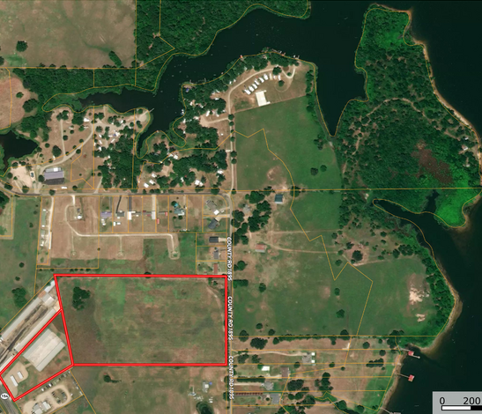
THE PARADISE THESIS
In Real Estate, Hotels, Apartments, and Storage are considered the Brass rings. We stay in Blue Ocean assets. When the ocean is red there is blood in the water, competition, and a feeding frenzy.
Meanwhile we focus on the blue ocean with almost no competitors.
The trends in RV ownership show the demand and we see much less competition for the assets in this class.
Owning an RV park today is like owning an Apartment building, plus a Hotel, times a Storage minus the building. A typical RV spot can be developed or bought for roughly $35,000 with similar income to a multi-family unit which typically costs $150k to build.
Paradise Park Ventures, Invest in Paradise.
Only 17% of the RV parks in America have Institutional funding.
Quality out-performs value
during periods of volatility.

Slide 28
The Paradise Pledge
Paradise People
People make the Paradise, so we build up our people to be Healthy Wealthy and Wise.
Paradise Properties
We create properties of lasting value using superior design
and amenities.
Paradise Profits
We thrill our capital partners with investor focused technology from the inception of our company.
Paradise Purpose
We Provide a home away from home while our guests escape their everyday lives.
Paradise Places
We Bring Paradise to the communities we build in and community in the places we build.

Slide 29
Paradise process
We look at 10-20 properties per month to find the one or two that fit into our strategy. The top requirement is a draw to the geographic area. Examples: Casino, Lake, River, Beach, Proximity to primary metro market, Ultra high presence of trades-workers. If there is a draw to the area, we look to see if the owners have outdated processes. If they have no website, That means no online booking, that means no Dynamic pricing. If we do nothing but add a website, online booking and Dynamic pricing we could double the current revenue in 6 months. A prime asset for us will have a Value-add component. Often, the owners planned to expand and have not. We will add more spaces and that adds to revenue. The sales prices for mom-and-pop RV Parks can vary wildly. We look for ones that aren’t even listed with a commercial broker. Many times, we are dealing with a residential realtor and therefore does not price the asset based on revenue but on the value of the comparable raw land or farms in the area.
Most assets have little to no financials
We comp the Average nightly rate from all competitors within 20 miles Then we use those comp rates to create projected financials based on the value-add potential. We don’t move on properties without the potential to 5x our investment. As we perform the Value add and rehab the current park, We put up the website and online booking.
We spend heavily on the initial marketing producing videos and social media content
Our Goal is to refi any debt and return all equity within 3-5 years, with a long-term emphasis on selling portfolios to Private Equity. When we have 20-30 performing assets, We will build portfolios of 10 in a geographic area to sell at top price.

Slide 30
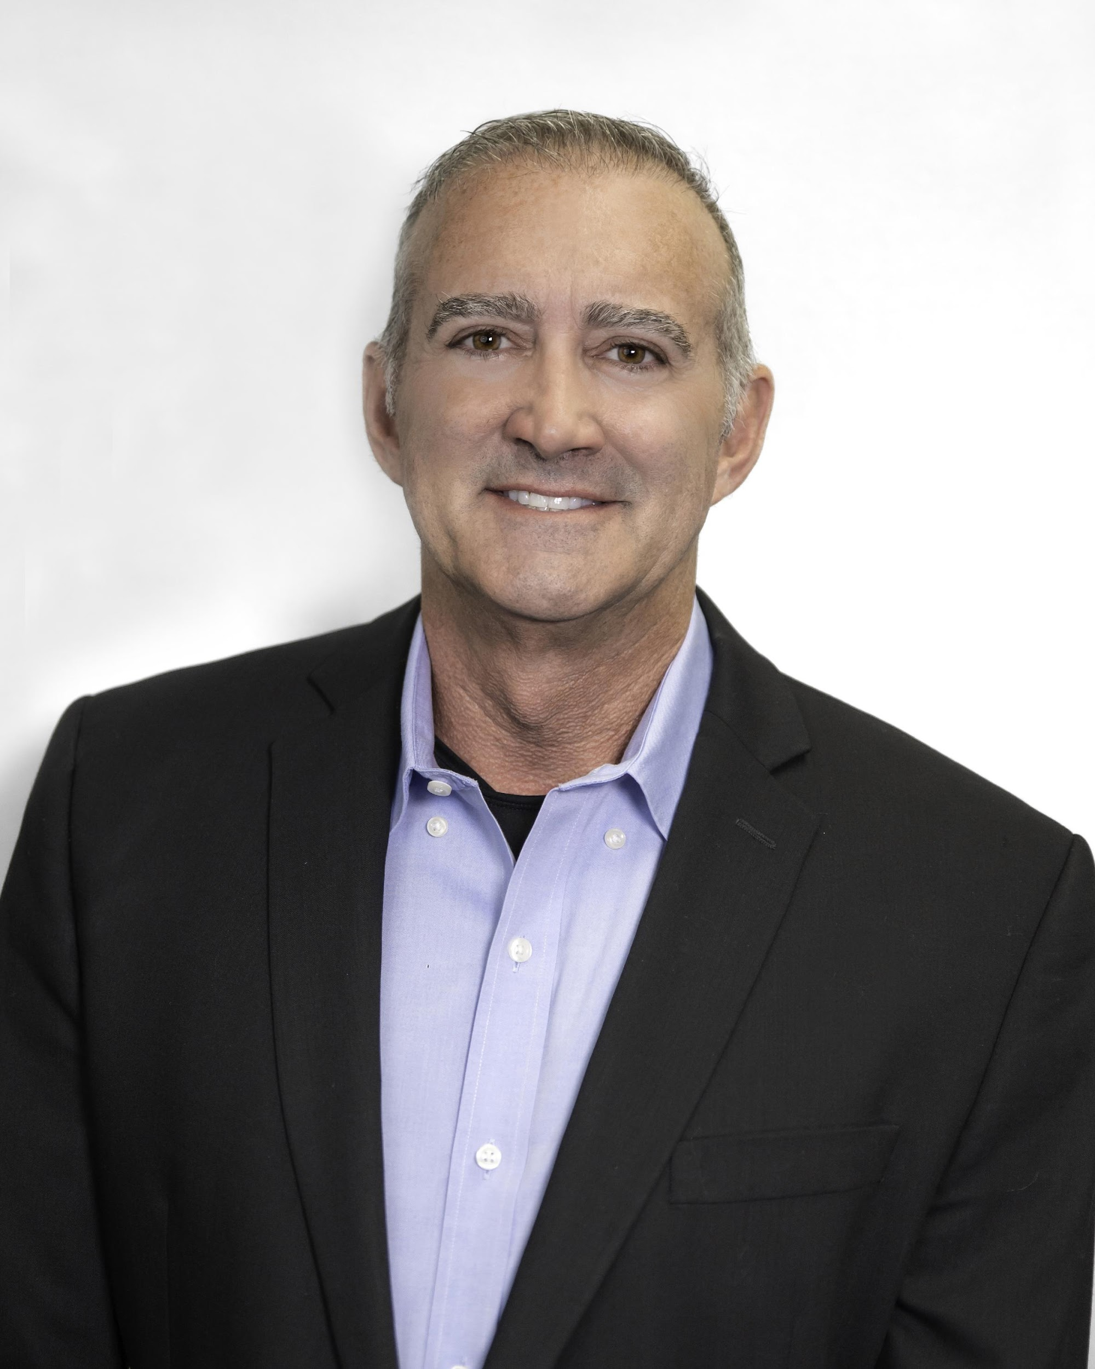
PARADISE TEAM
 | As a successful business and real estate professional, John has a reputation of swift and detailed responses to his investors. Professionals that invest with John most appreciate his timely payments of returns. He has 23 years of experience, giving him an understanding and respect for his investors that makes him refreshingly approachable and proficient. REAL ESTATE PROFESSIONAL DEVELOPMENT: Personal Member of Brad Sumrok’s Multifamily Investor Group Lifestyles Unlimited International Member 2008 DFW Real Estate Investment Association (REIA) Studied Rich Dad Poor Dad Guide to Investing Quest IRA Accounts Project Experience: Rising Sun RV Park Indiana (150 units) LP Design & Build single Family Homes Owner Ennis RV Resort (97 units) Owner/Developer Hickory Woods Senior Living (340 unit) GP Sleepy Hollow RV (120 Units). Oxford, IA LP West Dallas Manufactured Homes (263 Units) GP Eagles Nest RV Park (50 units) LP
JOHN MCGAUGH Chief Capital Markets Officer

Slide 31
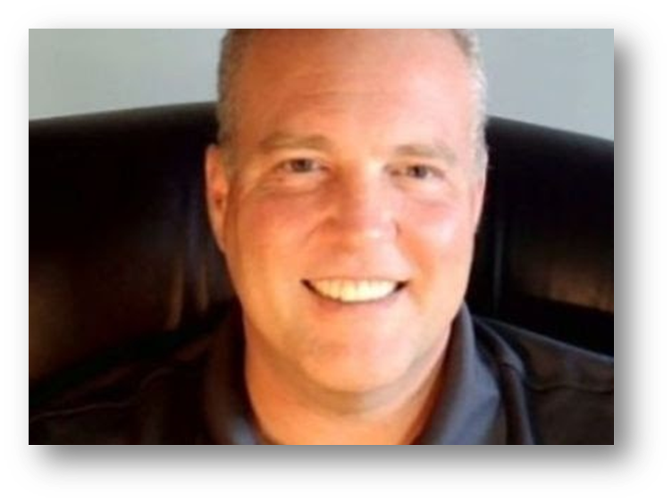
PARADISE TEAM
 | Alex Purchased his first Duplex in 2000 in Las Vegas NV. For a 3-year hold and 35% profit. 2005 Co-Founded Complete Event planning. A Las Vegas Convention housing company which Grossed $4.7mm in the first 6 months of operations. Today called the National Hotels Association. 2017 Bought his first raw acre of land on Big Island Hawaii. 2018 Owned 12 raw one-acre parcels of land on Big Island Hawaii, with rent to own buyers paying online through his website. 2020 Took on capital partners for $285k to buy 36 acres of land and complete rudimentary land development to sell as owner financed properties. Over 24 months that company has paid out $497,582 and has a current asset value of $828,110. Alex currently manages $1.6mm AUM and distributes roughly $20,000 per month among his equity partners.
Alex Alexander CIO Fund Manager

Slide 32
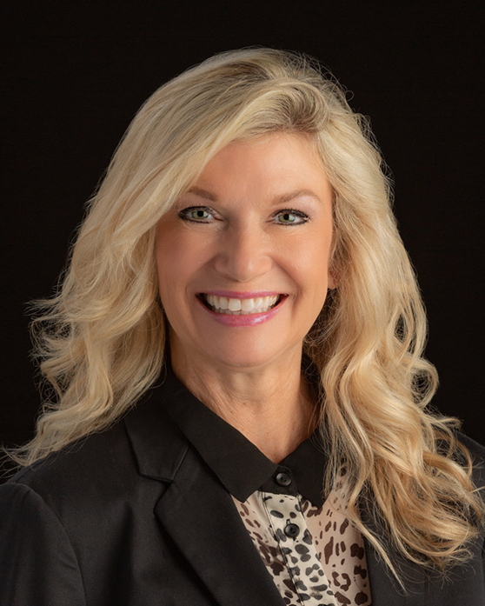
PARADISE TEAM
BuzzWorthy Property Management
 | Stephanie is committed to providing top-notch services to clients who own RV parks and campgrounds. Herur team of experienced professionals has extensive knowledge of the RV industry and understands the unique needs of RV park owners and guests. At BuzzWorthy Property Management, we pride ourselves on our ability to maximize our clients' returns on investment. Our team is always on the lookout for new revenue opportunities and cost-saving strategies to help our clients' businesses thrive. Whether you own a small RV park or a large campground, RV Property Management has the expertise and resources to help you achieve your goals. Trust us to take care of your property, so you can focus on providing an exceptional guest experience. ,Texas Sales Agent License #, 2019 C-Suite Award by Fort Worth Business Press, Certified Park Operator, National Association of RV Parks & Campgrounds School of Outdoor Hospitality. Texas Notary Public.
Stephanie Culver, CEO

Slide 33
CONTACT US
Alex Alexander
(808) 495-3586
integritylanddevelopment@gmail.com
JOHN MCGAUGH
(817) 727-9622
john@lsm-associates.com

